Slide 1
CSU –Starting the Journey

Slide 2
Determine Model
True CSU is 24/7 with max stay of 23 hours and 59 minutes – Spartanburg Model
CRCF- Ability to stay for multiple days – Charleston Dorchester Model
Other models as well – AZ model of “Urgent Care” - Mind 24-7 Serve everyone that walk through the door.
Other Models

Slide 3
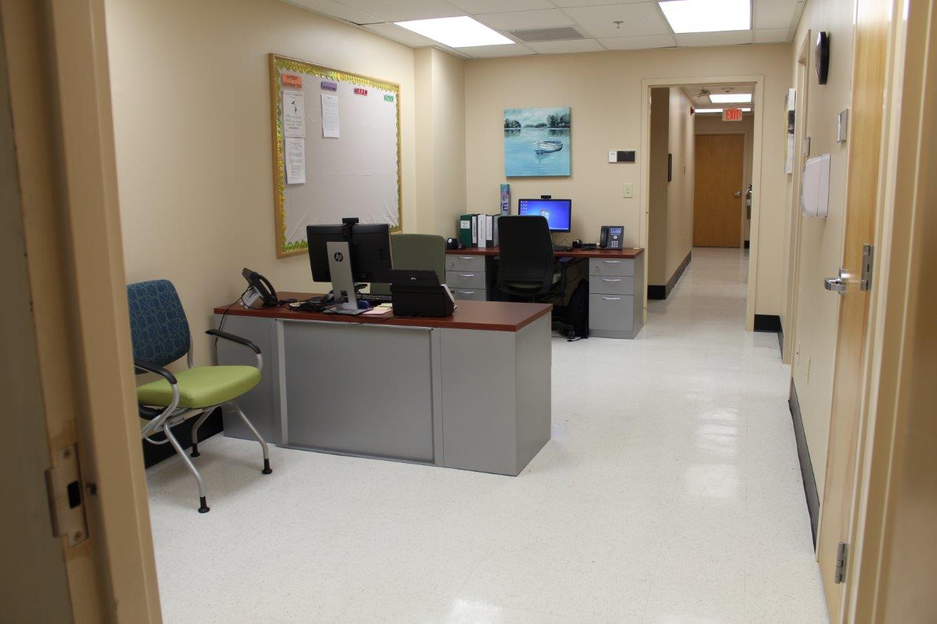
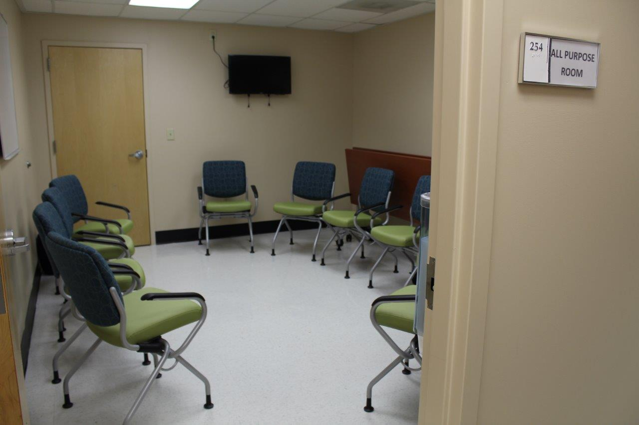
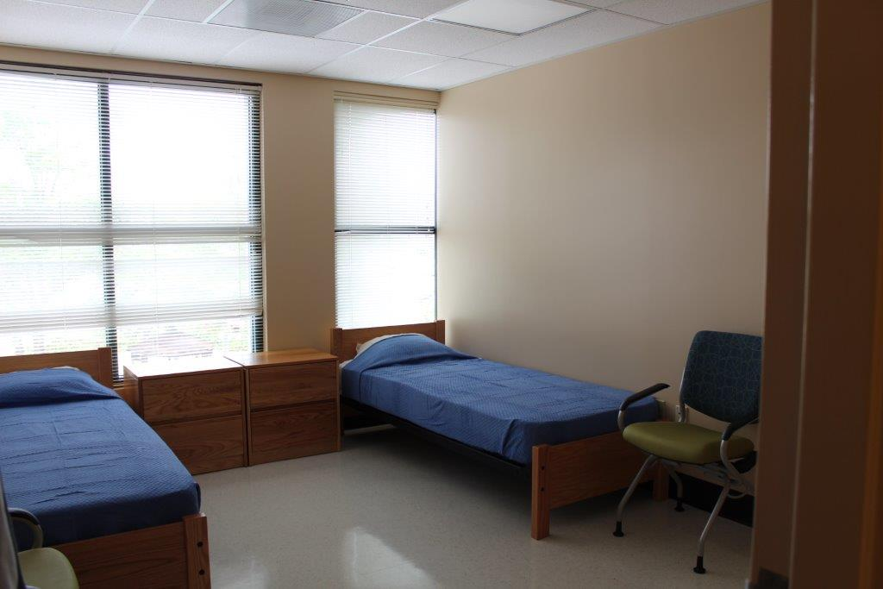
Tri-County Crisis Stabilization Center (TCSC)
Charleston Dorchester Mental Health Center
Reopened June 2017

Slide 4
An ED, Hospital, Jail Diversion Program
Appropriate level of care at the appropriate time by the appropriate staff; therefore:
Clinically appropriate emergency department (ED) diversion
Clinically appropriate inpatient hospital diversion
Legally appropriate jail diversion and triage option for law enforcement
Clinically and legally appropriate shortened length of stay (LOS) in ED, inpatient bed, jail
Option for stepdown/transfer from inpatient hospital or transfer from Sobering Center (soon to be opened next door)

Slide 5
Hours, services, staff:
Open 24/7 every day of the year
Housed in the Charleston Center building (DAODAS) to help link patients to treatment to Substance Use Disorders, when needed
Adjacent to the Sobering Center (soon to be open)
Staffed with Master’s prepared clinicians, Bachelor’s level clinicians, Registered Nurses, and Psychiatrists (to include PRN staff)
Patients are supported with group therapy, individual therapy, mental health assessments, psychiatric medical assessment, medications (If needed), PRS, Peer Support, entitlements, and nursing services.
24/7 Sheriff’s Deputy on site

Slide 6
CDMHC reopened TCSC on June 5, 2017. Startup budget – approximately $1,406,000.00. Recurring budget – approx. 1.5 mil.
24/7, 10 bed unit housed in Charleston Center (DAODAS)…. critical location.
Licensed as CRCF by SCDHEC – not a locked unit.
Criteria – 18+, voluntary, medically stable, in psychiatric distress, not violent, not intoxicated, able to participate in rigorous treatment regime.
The function – ED diversion, hospital diversion, jail diversion, triage service for law enforcement
Staffing – minimum of 5 on day shift, 2 on evening and 2 on night shift. RN on every shift. No less than BS/BA staff. Psychiatrist on site 3 hours 7 days a week and on call 24/7. 16 staff total + PRN staff. Crisis intervention, de-escalation, and assessment training critical.

Slide 7
TCSC Stats
(June 5, 2017- February 1, 2022)
2497 - Referrals
1549 - Admissions
185- Law Enforcement Triage calls
2.76 days - Average LOS
4.18 – Avg. census
    DIVERSIONS
38 – Jail
962 - MH inpatient hospital
472– ED & hospital

Slide 9
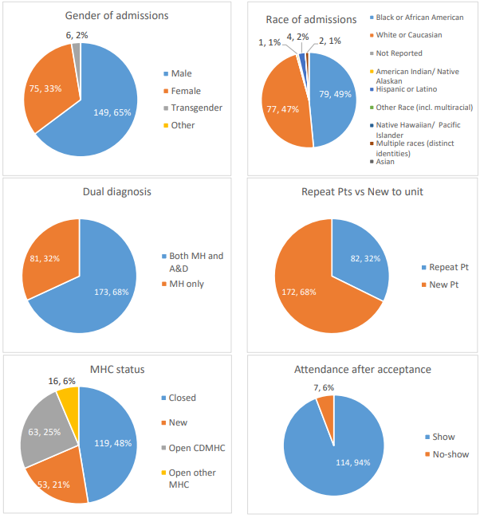

Slide 11
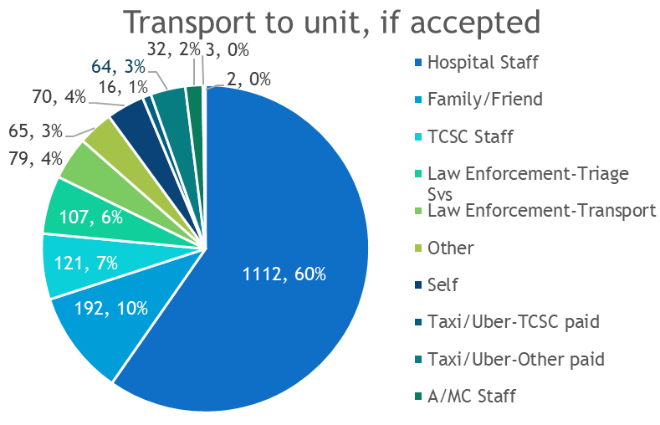
TCSC stats since opening

Slide 12
500/day up to 4 days, then further approval in 2 day increments from referring hospital up to 14 days
Current Changes to TCSC Hospital Funding – Per Diem
Pros:
Cons:
More likely to get hospitals on board, b/c the risk is on SCDMH
No financial risk for hospitals (pay as you play)
Better access to community
Increased access/usage should increase the average daily census
Transparency with stakeholders: quarterly financial and data reviews
For SCDMH, this is a big risk with no guaranteed funding to the unit. (CDMHC only changed to this after hx of usage to streamline costs per hospital).
To open a CSU, per diem funding would not work to create an initial opening budget. The risk needs to be on the community as it is a community issue.

