Slide 1
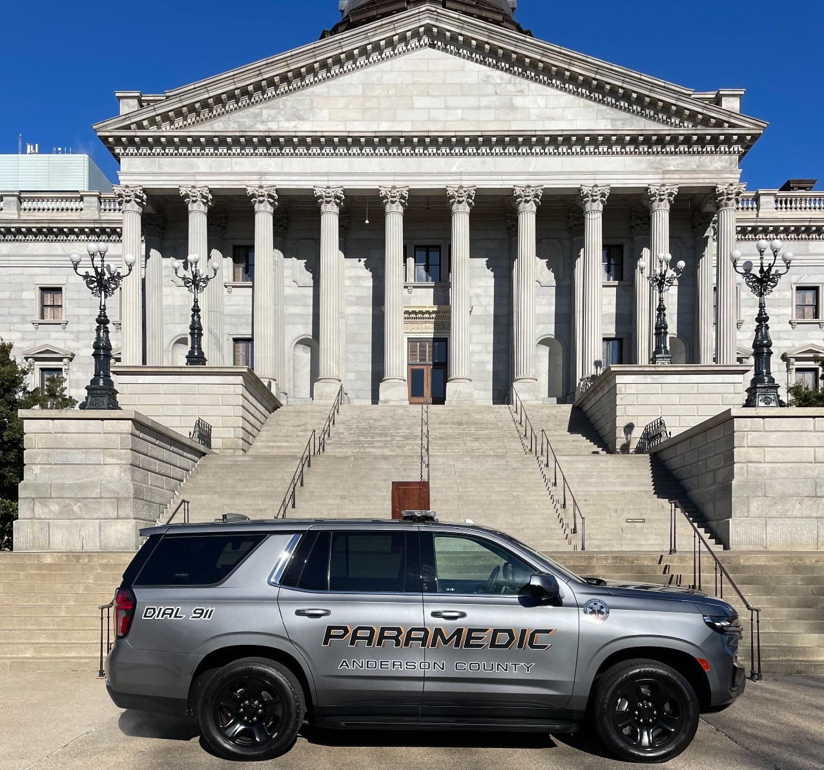
EMS Response Data
Notes:
Requested to SC Statehouse on January 17th 2024 to display unit and meet with Senators and Speakers

Slide 2
Response Numbers
Anderson County Emergency Medical Services operates as a truly tiered EMS System
A BLS Ambulance will be dispatched to all requests for service.
Depending on the severity, a Paramedic QRV could be sent.

Slide 3
Response Numbers
Notes:
% of QRV response still higher than expected. Will be addressed during April 2024

Slide 4
Response Compliance
EMS Compliance is calculated by a 3rd party with no ties to EMS
EMS has no input with response times calculation and are informed of the numbers upon completion of the data collection.
The response benchmark is 9 minutes and 59 seconds, 90% of the responses.

Slide 5
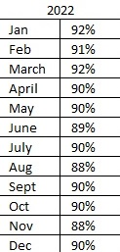
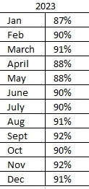
P1 Response Compliance
Notes:
Have not received Q124 data

