Slide 1
Welcome Residents of
District Seven

Slide 2
How the Zoning Process Works in Your Voting Precinct
1
Anderson County Planning and Development

Slide 3


Slide 4
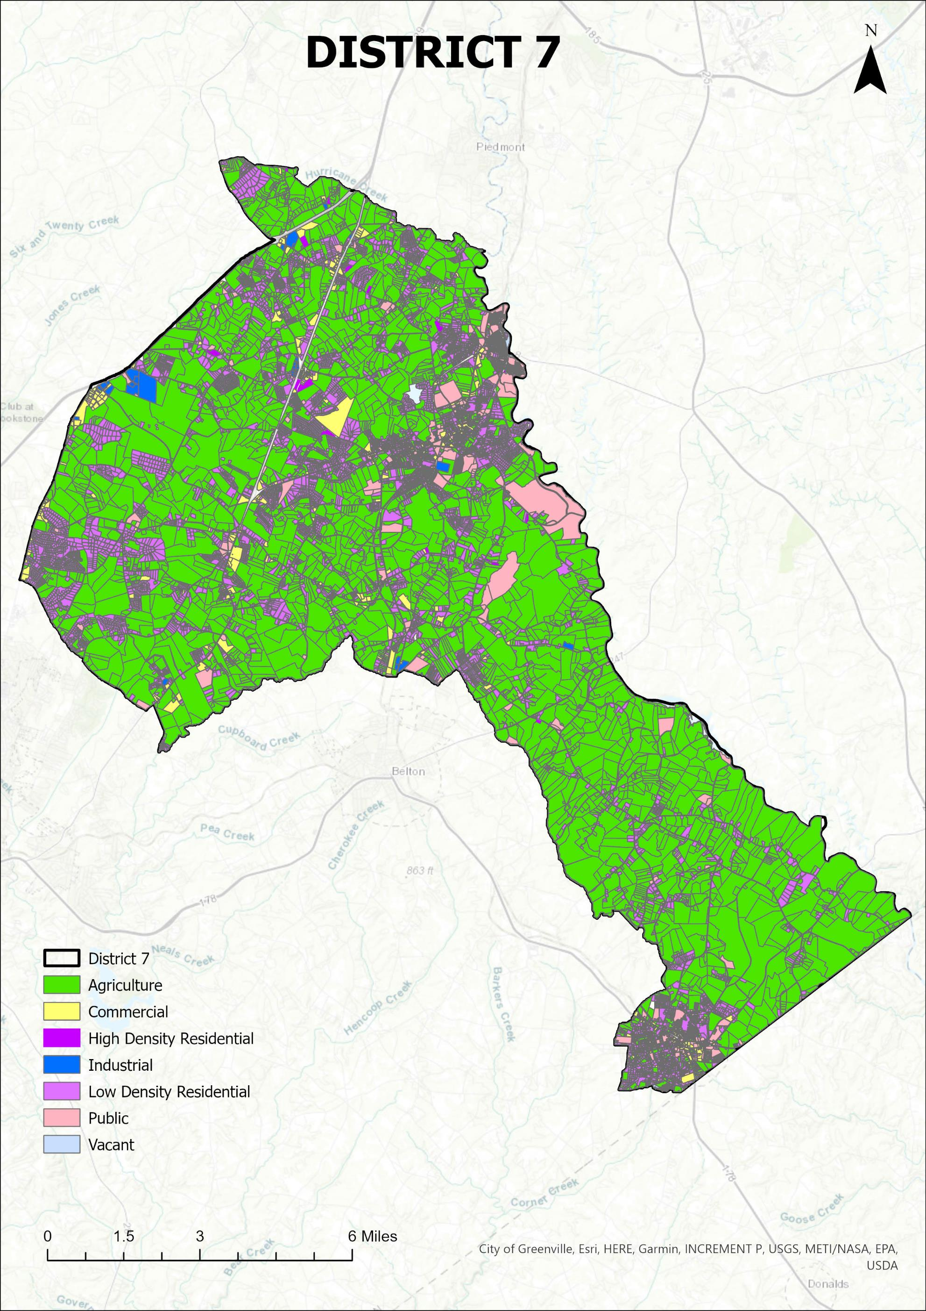

Slide 5
Obtain petition from Planning and Community Development Office.
Contact Registration and Elections Office to obtain number of voters in the precinct.
Gather at least 15% of the precinct's registered voters' signatures on petition.
Attend the public hearings and community meetings to provide comments
Vote in the referendum

Slide 6
Planning and Community Development Staff will log in the petition and submit it to the Registration and Elections Office
Registration and Elections Office will certify the signatures, schedule a referendum and notify County Council
After first reading of the proposed zoning map, the Planning and Community Development staff will hold a public meeting to present the proposed zoning map and receive comments
Planning Commission will review the proposal, hold a public hearing, and forward their recommendation to the County Council

Slide 7
• Zoning regulates the allowable uses of land in certain areas of Anderson County. “Rezoning” involves changes to the official zoning designation of a property. Property owners can request rezoning of their property at any time. The rezoning process does not apply to unzoned properties in the County. Rezoning is not a formality; it is a change to the County’s law governing the use of private property.
• The Planning Department processes requests for rezonings. The Department conducts an impartial review of the application and makes a recommendation to either approve or deny the request.
• The Planning Department makes itself available to rezoning applicants for meetings or phone calls to discuss their request.
• Receipt of a completed application for rezoning by the Department’s deadline ensures the request is placed on the following month’s public meeting cycle. These public meetings are:
1. Planning Commission
2. County Council 1st reading
3. County Council 2nd reading
4. County Council 3rd reading

Slide 8
• The Planning Department presents the application, including its recommendation, at these meetings. Applicants are required to attend all public meetings.
• Members of the public, including the applicant, have the opportunity to comment on the request at the Planning Commission meeting, and at the 1st Council reading.
• Postcards are sent to property owners within 2000 feet of the subject parcel, notifying them of the proposed change and the meeting schedule. Notice of the proposed change will also appear in a newspaper of general circulation.
A sign(s) will be posted 15 days prior to public hearing on the property, identifying the property as under consideration for rezoning. The sign will be removed upon completion of the rezoning process.
• A successful application typically requires about 90 days from the application deadline.
The Planning Department does not guarantee the outcome of any rezoning request.

Slide 9
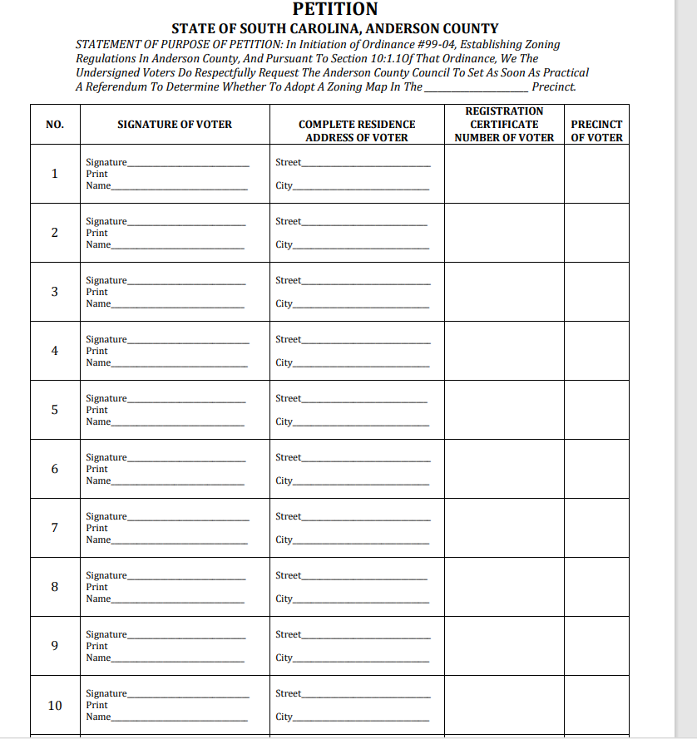

Slide 10
Anderson County Zoning Designations Available at Initial Zoning
(For a complete listing of all zoning districts and their descriptions,
please see Chapter 48 of the Anderson County Code of Ordinances.)
Agricultural-Residential Districts – Provides for a full range of agricultural activities in a residential setting. Single-family dwellings, including single and multi-section manufactured homes allowed.
The purpose of this district is to provide for a full range of agricultural activities in a rural setting. This district also provides for spacious residential development for those who choose this environment and prevents untimely scattering of more dense urban uses that should be confined to areas planned for efficient extension of public services.
R-A2: Two-acre minimum lot area. Must be requested by property owner or designated agent.
R-A:. One-acre minimum lot area.
Single-Family Residential Districts – Single-family dwellings, including multi-section manufactured homes allowed.
R-40: Minimum lot size of 40,000 square feet. R-20: Minimum lot size of 20,000 square feet.
R-15: Minimum lot size of 15,000 square feet. R-12: Minimum lot size of 12,000 square feet.
R-10: Minimum lot size of 10,000 square feet. R-8: Minimum lot size of 8,000 square feet.

Slide 11
Residential Duplex District
R-D: Provides for one and two family dwellings, transiting between low-density and high-density. Single-family dwellings - attached and detached, multi-section manufactured homes and two-family (duplex) dwellings allowed. Minimum lot size of 8,000 square feet
Mixed Residential District
R-M1: Provides for one and two family dwellings as well as a mixture of residential and professional offices, provided design and review conditions are met. Single-family dwellings – attached and detached, multi-section manufactured homes and two-family (duplex) dwellings allowed. Minimum lot size of 8,000 square feet
Multi-Family Residential Districts – Provides for two-family and multi-family dwellings, from medium density to high density. Single-family – attached and detached and multi-section manufactured homes, two-family (duplex) and multiple-family dwellings allowed.
R-M2: Minimum lot size of 8,000 square feet. Medium population density
R-M7: Minimum lot size of 8,000 square feet. Medium population density
R-M: Minimum lot size of 8,000 square feet. Medium to High population density
R-MA: Minimum lot size of 8,000 square feet. Single-section manufactured homes allowed. High population density

Slide 12
Residential Manufactured Home Park District
R-MHP: Single-section and multi-section manufactured home allowed. Located where public facilities and services are either existing or planned and compatible with adjoining and nearby properties. Minimum park size of 2 acres.
RRD, Residential Reuse District: RRD intent.
The purpose of this district is to provide an incentive to reuse structurally sound older buildings, located in residential districts, for which their original use is no longer economically viable. This section allows for building(s) to be developed for residential uses that are environmentally and aesthetically compatible with the surrounding residential area.
Office Districts
O-D: Office District. Provides for offices uses and research facilities, medical clinics and outpatient hospitals.
OD-LTD: Low Traffic Density Office District. Provides office space for lower density traffic generating uses.
POD, Planned Office District: This district is established to accommodate office development which is found to be compatible with surrounding physical development. Uses permitted in this district are limited to office and research facilities and shall not include any use engaged in retail sales or the stocking and storage of merchandise.

Slide 13
Commercial Districts
C-1: Commercial District. Provides commercial establishments for the convenience of local residents.
C-1N: Neighborhood Commercial District. Provides commercial development that is aesthetically compatible with neighboring residential properties.
C-1NB: Blended Neighborhood Commercial District. Ensures that new development is designed with the purpose of blending with the existing community features.
C-1R: Rural Commercial District. Provides for commercial activity in areas which are generally rural in character and for the convenience of local residents in rural areas.
C-2: Highway Commercial District. Provides for the development on major thoroughfares of commercial land uses which are oriented to customers traveling by automobile. Establishments in this district provide goods and services for the traveling public and also for the convenience of local residents.
C-3: Commercial District. Provides for the development of commercial and light service land uses which are oriented to customers traveling by automobile. The land uses in this district are intended to be located in non-residentially zoned areas and along major thoroughfares. Establishments in this district provide goods and services for the traveling public.

Slide 14
PC, Planned Commercial District: PC intent. The county recognizes that high-quality design of commercial structures can contribute to a positive appearance of commercial districts and neighborhoods and improve the overall character of the community.
The PC district is established to encourage innovative and creative design of commercial developments and to permit a greater amount of flexibility to a developer by removing some of the restrictions of conventional zoning. Ideally, the development should be large scale and incorporate a variety of land uses or land use types.
The regulations should provide a mechanism to evaluate each application on its own merit. It is recognized that some concepts will be more appropriate than others and the approval of an application in one location does not necessarily indicate the development will be applicable in other locations.
Services District
S-1: Provides a transition between commercial and industrial districts by allowing: 1) commercial uses which are service related; 2) service-related commercial uses which sell merchandise related directly to the service performed; 3) commercial uses which sell merchandise which requires storage in warehouses or outdoor areas; and 4) light industries which in their normal operations would have a minimal effect on adjoining properties outside the industrial park. The physical and operational requirements of the use, including type of structure used and volume of heavy truck traffic generated, shall not have an adverse impact upon surrounding land uses. Regulations are directed toward protecting neighboring land uses from any of the potential nuisances associated with industrial uses. Industrial District
I-1: Provides for manufacturing plants, assembly plants and warehouses.
I-2, Industrial Park District.

Slide 15
This district is established to provide a high level of design quality, site amenities, and open space for light industry, warehouse distribution, research and development operations, and similar industrial uses with compatible operations within a park atmosphere. All of the uses shall be of a type or intensity that do not produce odors, smoke, fumes, noise, glare, heat or vibrations which are incompatible with other uses in the park or its surrounding land uses outside the industrial park. The physical and operational requirements of the use, including type of structure used and volume of heavy truck traffic generated, shall not have an adverse impact upon surrounding land uses. Regulations are directed toward protecting neighboring land uses from any of the potential nuisances associated with industrial uses.
PD, Planned Development District: PD intent.
The PD district is established to allow flexibility in development that will result in improved design, character, and quality of new mixed-use developments and preserve natural and scenic features of open spaces. Ideally, the development should be large scale and incorporate a variety of land uses or land use types. The district is also intended to encourage developments which provide a full range of residential types to serve the residents of the district. The planned development regulations must encourage innovative site planning for residential, commercial, institutional, and industrial developments within planned development districts. The regulations should provide a mechanism to evaluate each application on its own merit. It is recognized that some concepts will be more appropriate than others and the approval of an application in one location does not necessarily indicate the development will be applicable in other locations. It should also be emphasized that these provisions are not to be used to circumvent the intent or use of conventional zoning classifications as set forth in this chapter.

Slide 16
For more zoning classifications and information regarding zoning conditions, please refer to the county webpage at www.andersoncountysc.org and use this link:
https://library.municode.com/sc/anderson_county/codes/code_of_ordinances?nodeId=COOR_CH48ZO

Slide 17

This has been a presentation of the
Anderson County
PLANNING & DEVELOPMENT DIVISION
O: 864-260-4719 | F: 864-260-4795
Development Standards
401 E. River Street, Anderson SC 29624
www.andersoncountysc.org

