Slide 1

WELCOME
Precincts of District 2 and District 3
Honorable Glenn Davis-District 2
Honorable Greg Elgin- District 3
Thank you all for coming out this evening to learn about precinct zoning and steps to take with our upcoming referendum and decide upon future dates for upcoming precinct meetings.
Staff will talk with you regarding the process, and answer questions, and with this, I will turn it over to staff.

Slide 2

Zoning Referendum Shirley store neal’s creek, and rock spring precincts 2025

Slide 3
Referendum Date Change Matt Hogan Deputy County Administrator

Slide 4
Overview
1
Process of Precinct Zoning
2
Precinct Maps
3
Discussion of Meetings/Schedule
4
Meeting Notifications
5
Draft of Ordinance/First Reading
6
Planning Commission’s Role
7
Referendum – November 4, 2025
8
Council Third Reading and Adoption
4

Slide 5
Voting schedule for Anderson county

Slide 6
The election date would be November 4th, 2025.
The voter registration cutoff would be Sunday, October 5th, for online and voter registration by mail. In person voter registration will be Friday, October 3rd at 5:00 PM.
Early Voting will take place at the Registration & Elections office located at 301 N Main Street, Anderson, 29621, beginning Monday, October 20, 2025, through Friday, October 31st. It will be Monday – Friday, 8:30 -5:00 pm. No weekends.
Absentee by mail ballots will be available the week of October 1st, 2025.
There will be 2 election notices closer to the election cycle.

Slide 7
1. Obtain petition from Planning and Community Development Office. 2. Contact Registration and Elections Office to obtain number of voters in the precinct. 3. Gather at least 15% of the precinct's registered voters' signatures on petition. 4. Attend the public hearings and community meetings to provide comments 5. Vote in the referendum
Precinct Zoning Process – Voter Responsibilities

Slide 8
1. Planning and Community Development Staff will log in the petition and submit it to the Registration and Elections Office 2. Registration and Elections Office will certify the signatures, schedule a referendum and notify County Council 3. After first reading of the proposed zoning map, the Planning and Community Development staff will hold a public meeting to present the proposed zoning map and receive comments 4. Planning Commission will review the proposal, hold a public hearing, and forward their recommendation to the County Council
Precinct Zoning Process – Staff Responsibilities

Slide 9
1. Council will hold first reading of the application for zoning, then send it to the Planning and Community Development Staff for presentation to the Planning Commission for their recommendations 2. After receiving a recommendation from the Planning Commission, Council will hold a public hearing to consider second reading for the zoning request 3. Following the referendum, when the application for zoning has been ratified, Council will hold its third and final reading for adoption of the updates to the zoning map
Precinct Zoning Process – Council Responsibilities

Slide 10
Council Schedule
Sunday | Monday | Tuesday | Wednesday | Thursday | Friday | Saturday
 |  | Planning Commission |  | Board of Zoning Appeals
 | County Council Meeting
 | County Council Meeting

Slide 12
Meeting Dates
Sunday | Monday | Tuesday | Wednesday | Thursday | Friday | Saturday
 |  | Election Day is November 4th

Slide 13
8 | Prepare draft zoning map | To go out in PC packet on September 30, 2025 | Staff
9 | Planning Commission consideration and recommendation to Council | September 9, 2025 public hearing | Planning Commission
10 | Absentee by mail ballots | Available October 1, 2025
11 | In person voter registration cut off | October 3, 2025 at 5:00
12 | Online and by Mail Voter Registration Cut Off | October 5, 2025
13 | First reading of Zoning Map Amendment for Shirley’s Store, Neal’s Creek, and Rock Springs Precincts | October 7, 2025 | County Council
14 | Prepare final maps and get copy to the Registration and Election Commission | October 14, 2025 | Staff
15 | Second reading and public hearing (Advertise public hearing) | October 20, 2025 | Council
16 | Early voting | Begins October 20-31, 2025 Monday – Friday, 8:30 -5:00 pm. No weekends. | Voters
17 | Referendum | November 4, 2025 | Voters
18 | Third reading (if referendum passes) | November 17, 2025 | Council

Slide 14
current precinct maps

Slide 15
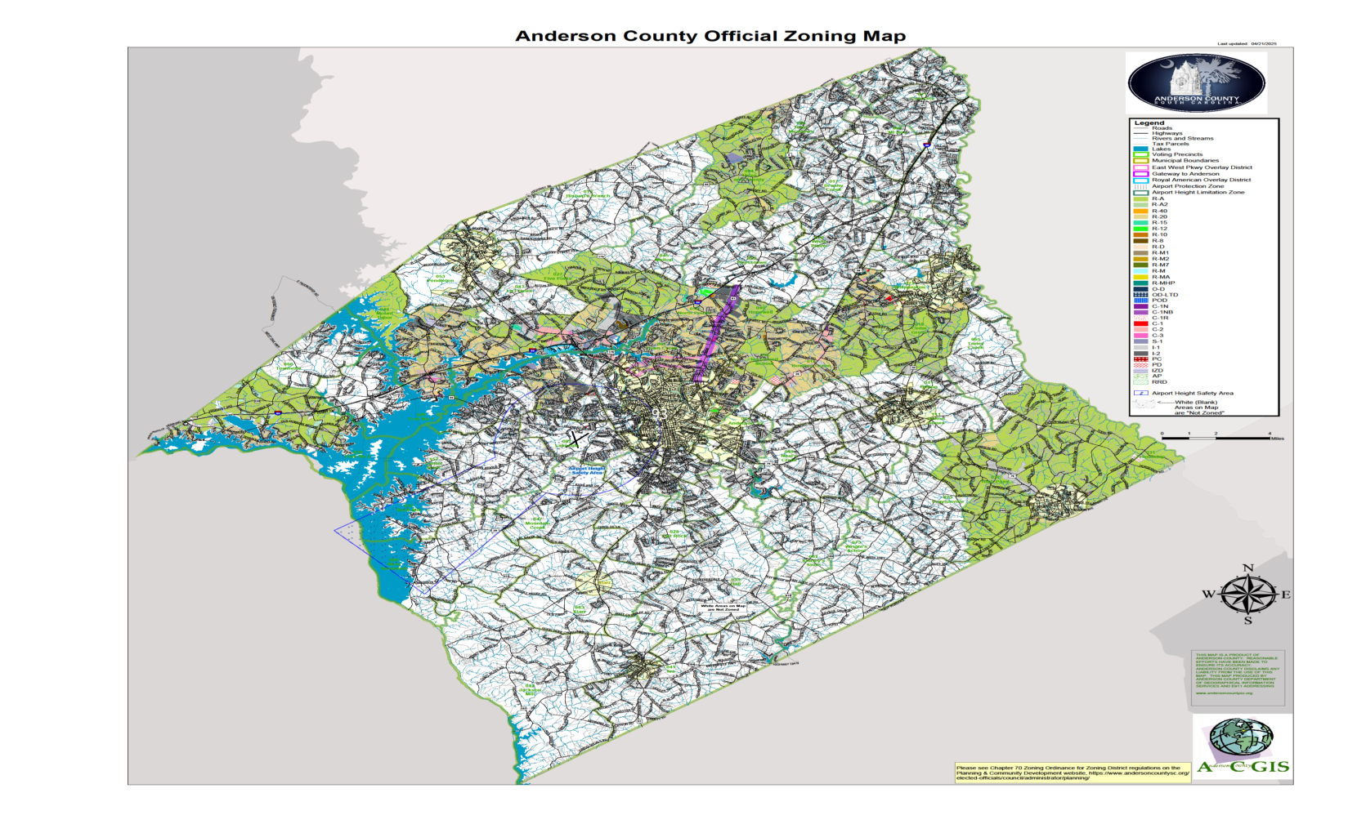

Slide 16
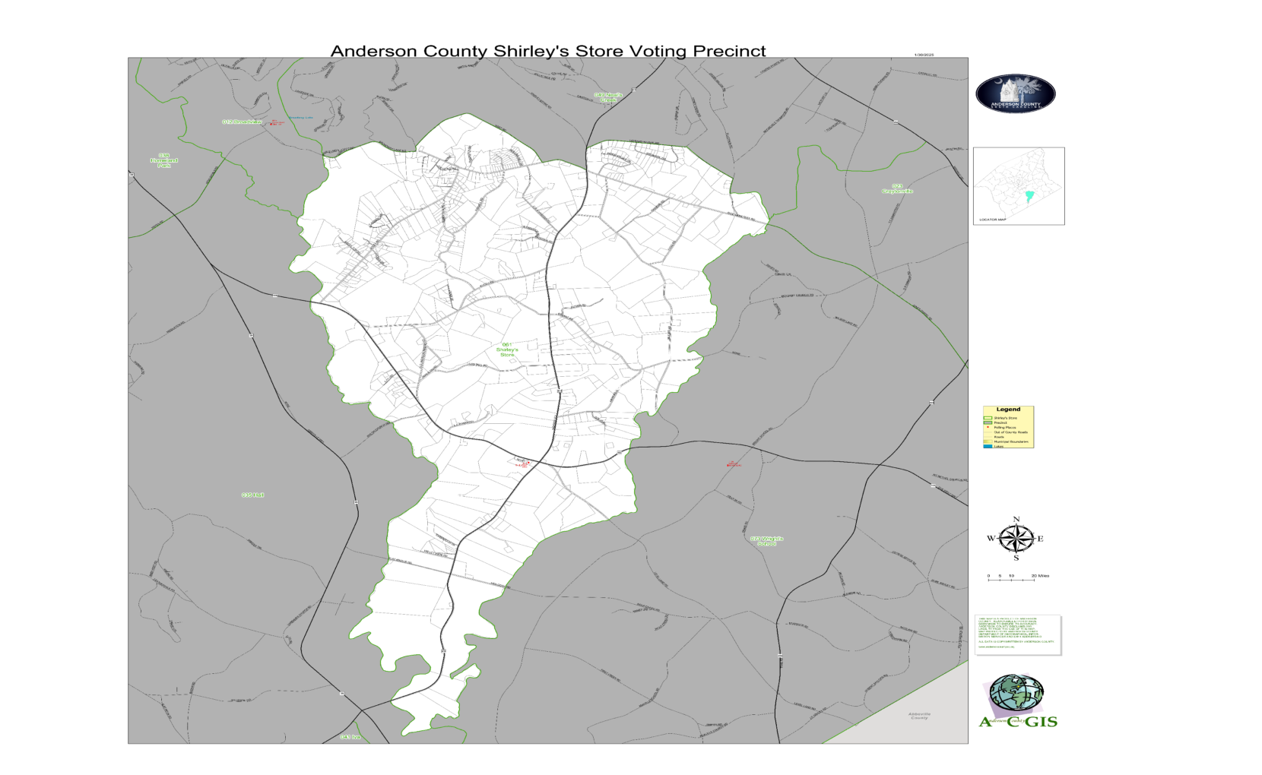

Slide 17
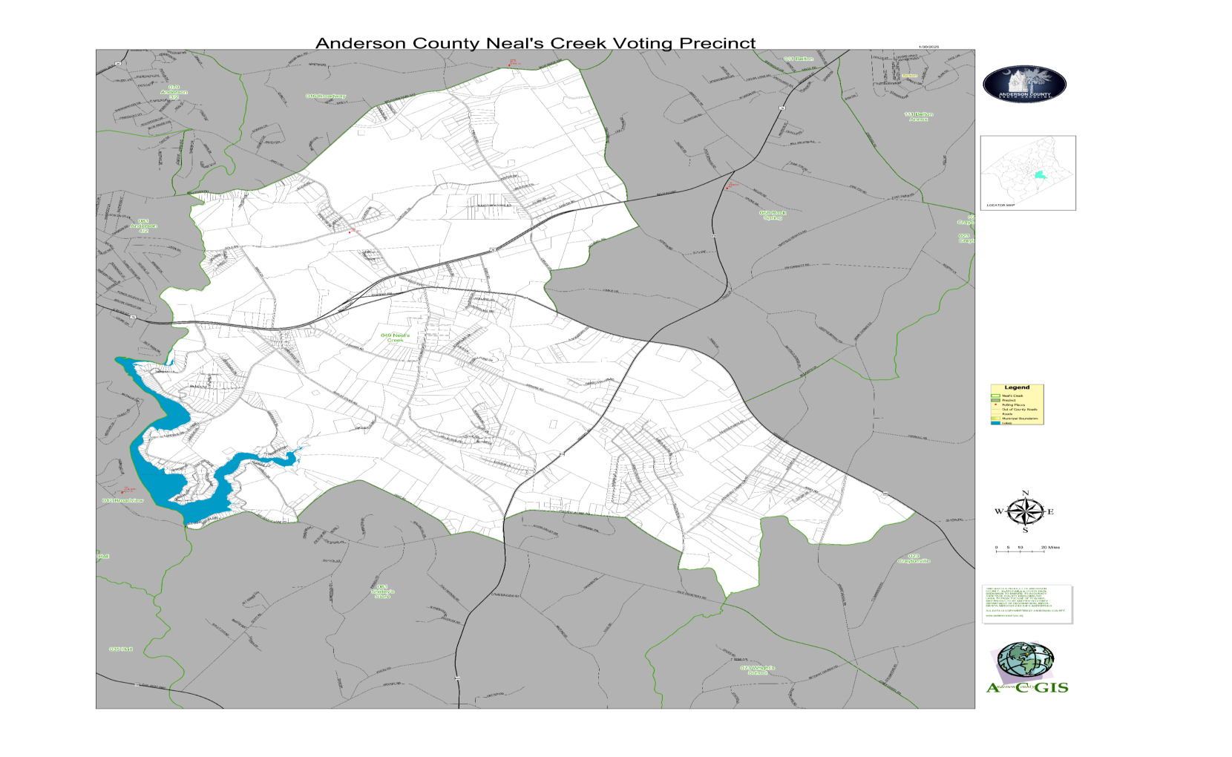

Slide 18
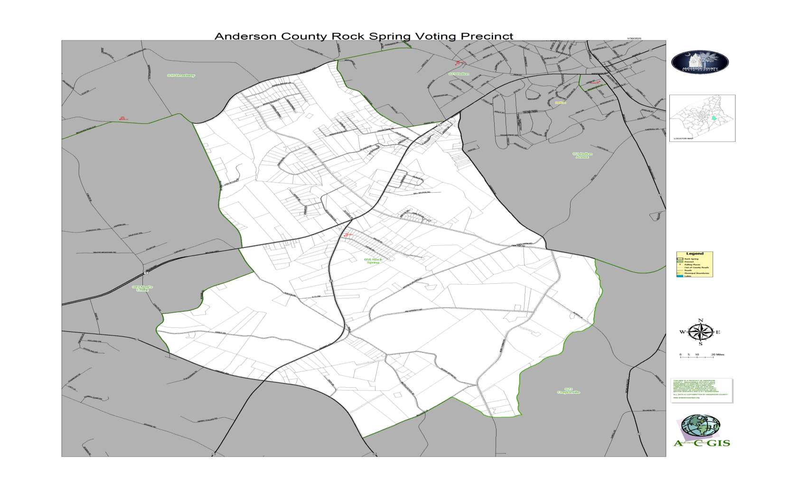

Slide 20
Schedule -Write ordinance -community meetings (Joint or separate meetings) -Notification to property owners -planning commission consideration -Second reading -referendum – November 4, 2025 -Third reading if referendum passes

Slide 21
Zoning Definitions and Classifications

Slide 22
Anderson County Zoning Designations Available at Initial Zoning (For a complete listing of all zoning districts and their descriptions, please see Chapter 48 of the Anderson County Code of Ordinances.) Agricultural-Residential Districts – Provides for a full range of agricultural activities in a residential setting. Single-family dwellings, including single and multi-section manufactured homes allowed. The purpose of this district is to provide for a full range of agricultural activities in a rural setting. This district also provides for spacious residential development for those who choose this environment and prevents untimely scattering of more dense urban uses that should be confined to areas planned for efficient extension of public services. R-A:. One-acre minimum lot area. R-A2: Two-acre minimum lot area. (R-A2 and above Must be requested by property owner or designated agent.) Single-Family Residential Districts – Single-family dwellings, (including multi-section manufactured homes allowed.) R-40: Minimum lot size of 40,000 square feet. R-20: Minimum lot size of 20,000 square feet. R-15: Minimum lot size of 15,000 square feet. R-12: Minimum lot size of 12,000 square feet. R-10: Minimum lot size of 10,000 square feet. R-8: Minimum lot size of 8,000 square feet.

Slide 23
Residential Duplex District R-D: Provides for one and two family dwellings, transiting between low-density and high-density. Single-family dwellings - attached and detached, multi-section manufactured homes and two-family (duplex) dwellings allowed. Minimum lot size of 8,000 square feet Mixed Residential District R-M1: Provides for one and two family dwellings as well as a mixture of residential and professional offices, provided design and review conditions are met. Single-family dwellings – attached and detached, multi-section manufactured homes and two-family (duplex) dwellings allowed. Minimum lot size of 8,000 square feet Multi-Family Residential Districts – Provides for two-family and multi-family dwellings, from medium density to high density. Single-family – attached and detached and multi-section manufactured homes, two-family (duplex) and multiple-family dwellings allowed. R-M2: Minimum lot size of 8,000 square feet. Medium population density R-M7: Minimum lot size of 8,000 square feet. Medium population density R-M: Minimum lot size of 8,000 square feet. Medium to High population density R-MA: Minimum lot size of 8,000 square feet. Single-section manufactured homes allowed. High population density

Slide 24
Residential Manufactured Home Park District R-MHP: Single-section and multi-section manufactured home allowed. Located where public facilities and services are either existing or planned and compatible with adjoining and nearby properties. Minimum park size of 2 acres. RRD, Residential Reuse District: RRD intent. The purpose of this district is to provide an incentive to reuse structurally sound older buildings, located in residential districts, for which their original use is no longer economically viable. This section allows for building(s) to be developed for residential uses that are environmentally and aesthetically compatible with the surrounding residential area. Office Districts O-D: Office District. Provides for offices uses and research facilities, medical clinics and outpatient hospitals. OD-LTD: Low Traffic Density Office District. Provides office space for lower density traffic generating uses. POD, Planned Office District: This district is established to accommodate office development which is found to be compatible with surrounding physical development. Uses permitted in this district are limited to office and research facilities and shall not include any use engaged in retail sales or the stocking and storage of merchandise.

Slide 25
Commercial Districts C-1: Commercial District. Provides commercial establishments for the convenience of local residents. C-1N: Neighborhood Commercial District. Provides commercial development that is aesthetically compatible with neighboring residential properties. C-1NB: Blended Neighborhood Commercial District. Ensures that new development is designed with the purpose of blending with the existing community features. C-1R: Rural Commercial District. Provides for commercial activity in areas which are generally rural in character and for the convenience of local residents in rural areas. C-2: Highway Commercial District. Provides for the development on major thoroughfares of commercial land uses which are oriented to customers traveling by automobile. Establishments in this district provide goods and services for the traveling public and also for the convenience of local residents. C-3: Commercial District. Provides for the development of commercial and light service land uses which are oriented to customers traveling by automobile. The land uses in this district are intended to be located in non-residentially zoned areas and along major thoroughfares. Establishments in this district provide goods and services for the traveling public. PC, Planned Commercial District: PC intent. The county recognizes that high-quality design of commercial structures can contribute to a positive appearance of commercial districts and neighborhoods and improve the overall character of the community.

Slide 26
The PC district is established to encourage innovative and creative design of commercial developments and to permit a greater amount of flexibility to a developer by removing some of the restrictions of conventional zoning. Ideally, the development should be large scale and incorporate a variety of land uses or land use types. The regulations should provide a mechanism to evaluate each application on its own merit. It is recognized that some concepts will be more appropriate than others and the approval of an application in one location does not necessarily indicate the development will be applicable in other locations. Services District S-1: Provides a transition between commercial and industrial districts by allowing: 1) commercial uses which are service related; 2) service-related commercial uses which sell merchandise related directly to the service performed; 3) commercial uses which sell merchandise which requires storage in warehouses or outdoor areas; and 4) light industries which in their normal operations would have a minimal effect on adjoining properties. Industrial District I-1: Provides for manufacturing plants, assembly plants and warehouses. I-2, Industrial Park District. This district is established to provide a high level of design quality, site amenities, and open space for light industry, warehouse distribution, research and development operations, and similar industrial uses with compatible operations within a park atmosphere. All of the uses shall be of a type or intensity that do not produce odors, smoke, fumes, noise, glare, heat or vibrations which are incompatible with other uses in the park or its surrounding land uses outside the industrial park.

Slide 27
The physical and operational requirements of the use, including type of structure used and volume of heavy truck traffic generated, shall not have an adverse impact upon surrounding land uses. Regulations are directed toward protecting neighboring land uses from any of the potential nuisances associated with industrial uses. PD, Planned Development District: PD intent. The PD district is established to allow flexibility in development that will result in improved design, character, and quality of new mixed-use developments and preserve natural and scenic features of open spaces. Ideally, the development should be large scale and incorporate a variety of land uses or land use types. The district is also intended to encourage developments which provide a full range of residential types to serve the residents of the district. The planned development regulations must encourage innovative site planning for residential, commercial, institutional, and industrial developments within planned development districts. The regulations should provide a mechanism to evaluate each application on its own merit. It is recognized that some concepts will be more appropriate than others and the approval of an application in one location does not necessarily indicate the development will be applicable in other locations. It should also be emphasized that these provisions are not to be used to circumvent the intent or use of conventional zoning classifications as set forth in this chapter.

Slide 28
AP, Airport Protective areas: Airport protective areas established as supplementary. The "AP" designation is not intended to be utilized as a district classification but as a designation which identifies areas subject to regulations which are supplementary to the regulations of the district to which such designation is attached, appended, or "overlaid." Regulations which apply to areas designated on the zoning map as being within such appended or overlaid designation must be determined by joint reference to the regulations of both the basic district classification and the appended or overlay classification. The basis for preparing these supplementary regulations is contained in the Federal Aviation Regulations (FAR), Vol. XI, Part 77, "Objects Affecting Navigable Airspace.“ Innovative Zoning District (IZOD): IZOD, intent. The IZOD district is established to allow flexibility in development that will result in improved design, character, and quality of new developments as well as preserve natural and scenic features of open spaces. The innovative zoning district regulations must encourage innovative site planning for residential, commercial, institutional, or industrial development within the district. R-C, Residential Conservation District: The purpose of this district is to help preserve and enhance the character [of] established residential neighborhoods. The district promotes compatible new construction within the district's built environment in order to strengthen and build upon those desirable physical features already existing. .

Slide 29
Conservation Subdivision: Conservation subdivision with cluster design to have minimum lot sizes of 6,000 sq. ft. and side setbacks of minimum six feet or ten percent of lot width, whichever is greater. Subdivision is required to preserve at least 20 percent of open green space. Green spaces can include natural features such as wetlands and streams, recreational areas such as playgrounds and ball fields, greenways, and landscaped areas. The percentage of open space cannot include the required bufferyard. Developers are recommended to walk the property to determine which aspects of the property to preserve. FA, Forest Agriculture District: The purpose of the district is to accommodate most agriculture uses and small-scale development in areas with limited or unavailable public infrastructure. AG-C, Agriculture Conservation District: The purpose of this district is to protect and preserve areas under cultivation and prime agricultural soils for continued agricultural and agriculturally oriented uses and to protect the business of agriculture. Lot area. The minimum lot area shall be five acres. RRD, Rural Residential District: The purpose of this district is to provide areas wanting to protect the rural nature of their community but allow for limited residential growth. The intent of this district is to allow for residential development in rural areas that wish to minimize the impact of dense residential development. The minimum lot area shall be three acres.

Slide 30
THANK YOU!

